Slide 1

Introduction to Data Analytics
PROFESSIONAL CERTIFICATE IBM Data Analyst
Notes:
Good morning everyone, we will start our IBM ……., today we will cover course 1 week 1 which is about Introduction to data analytics

Slide 2
Agenda
Analyzing and Mining Data
Communicating Data Analysis Findings

Slide 3
Analyzing And Mining Data

Slide 4
Statistical Analysis
Statistical knowledge helps you use the proper methods to collect the data, employ the correct analyses, and effectively present the results. Statistics is a crucial process behind how we make discoveries in science, make decisions based on data, and make predictions.
Statistical Analysis can be:
Descriptive; that which provides a summary of what the data represents. Common measures include Central Tendency, Dispersion, and Skewness.
Inferential; that which involves making inferences, or generalizations, about data. Common measures include Hypothesis Testing, Confidence Intervals, and Regression Analysis.
Notes:
Data analysis and statistics are extremely important to many fields. In fact, statistics and data analysis are crucial for conducting internal audits and performance reviews. In many industries like marketing, research, financial services and medical or clinical research, statistics and data analysis are crucial. This is true because of the inherent power of statistics in the analyzing of data. Statistics can also be essential to achieve extremely important growth and efficiency objectives. Because it is so important for businesses to use statistics to lead to meaningful results, interpretations and business decisions, the importance of statistics can not be overstated. Unfortunately, sometimes busin

Slide 5
Data Mining
Data mining is also called knowledge discovery and data mining (KDD)
Data mining is
extraction of useful patterns from data sources, e.g., databases, texts, web, image. Extraction of interesting (non-trivial, implicit, previously unknown and potentially useful) patterns or knowledge from huge amount of data
Patterns must be:
valid, novel, potentially useful, understandable

Slide 6
Example of discovered patterns
Association rules:
“80% of customers who buy cheese and milk also buy bread, and 5% of customers buy all of them together”

Slide 7
Potential Applications
Here is the list of areas where data mining is widely used −
Financial Data Analysis
Retail Industry
Telecommunication Industry
Biological Data Analysis
Other Scientific Applications
Intrusion Detection
Notes:
Data analysis and decision support
Market analysis and management
Target marketing, customer relationship management (CRM),
market basket analysis, cross selling, market segmentation
Risk analysis and management
Forecasting, customer retention, improved underwriting, quality
control, competitive analysis
Fraud detection and detection of unusual patterns (outliers)
Other Applications
Text mining (news group, email, documents) and Web mining
Stream data mining
Bioinformatics and bio-data analysis

Slide 8
Data Mining Applications
Financial Data Analysis
The financial data in banking and financial industry is generally reliable and of high quality which facilitates systematic data analysis and data mining.
Retail Industry
Data Mining has its great application in Retail Industry because it collects large amount of data from on sales, customer purchasing history, goods transportation, consumption and services. Data mining in retail industry helps in identifying customer buying patterns and trends that lead to improved quality of customer service and good customer retention and satisfaction.
Telecommunication Industry
Data mining in telecommunication industry helps in identifying the telecommunication patterns, catch fraudulent activities, make better use of resource, and improve quality of service.
Biological Data Analysis
In recent times, we have seen a tremendous growth in the field of biology such as genomics, proteomics, functional Genomics and biomedical research. Biological data mining is a very important part of Bioinformatics.
Notes:
Financial:
Some of the typical cases are as follows −
Design and construction of data warehouses for multidimensional data analysis and data mining.
Loan payment prediction and customer credit policy analysis.
Classification and clustering of customers for targeted marketing.
Detection of money laundering and other financial crimes
Retail industry:
Here is the list of examples of data mining in the retail industry −
Design and Construction of data warehouses based on the benefits of data mining.
Multidimensional analysis of sales, customers, products, time and region.
Analysis of effectiveness of sales campaigns.
Customer Retention.
Product recommendation and cross-referencing of items.
Tele
Here is the list of examples for which data mining improves telecommunication services −
Multidimensional Analysis of Telecommunication data.
Fraudulent pattern analysis.
Identification of unusual patterns.
Multidimensional association and sequential patterns analysis.
Mobile Telecommunication services.
Use of visualization tools in telecommunication data analysis
Bio
Following are the aspects in which data mining contributes for biological data analysis −
Semantic integration of heterogeneous, distributed genomic and proteomic databases.
Alignment, indexing, similarity search and comparative analysis multiple nucleotide sequences.
Discovery of structural patterns and analysis of genetic networks and protein pathways.
Association and path analysis.
Visualization tools in genetic data analysis.

Slide 9
Ex: Market Analysis and Management
Where does the data come from?—Credit card transactions, loyalty cards,
discount coupons, customer complaint calls, surveys …
Target marketing
Find clusters of “model” customers who share the same characteristics: interest,
income level, spending habits, etc.,
E.g. Most customers with income level 60k – 80k with food expenses $600 - $800 a month live in that area
Determine customer purchasing patterns over time
E.g. Customers who are between 20 and 29 years old, with income of 20k – 29k usually buy this type of CD player
Cross-market analysis—Find associations/co-relations between product sales, & predict based on such association
E.g. Customers who buy computer A usually buy software B

Slide 10
Customer requirement analysis
Identify the best products for different customers
Predict what factors will attract new customers
Provision of summary information
Multidimensional summary reports
E.g. Summarize all transactions of the first quarter from three different branches
Summarize all transactions of last year from a particular branch
Summarize all transactions of a particular product
Statistical summary information
E.g. What is the average age for customers who buy product A?
Fraud detection
Find outliers of unusual transactions
Financial planning
Summarize and compare the resources and spending

Slide 11
Data Mining Techniques
Classification
Clustering
Regression
Association Rules/ Affinity Grouping
Anomaly or outlier detection
Sequential Patterns
Decision Trees

Slide 12
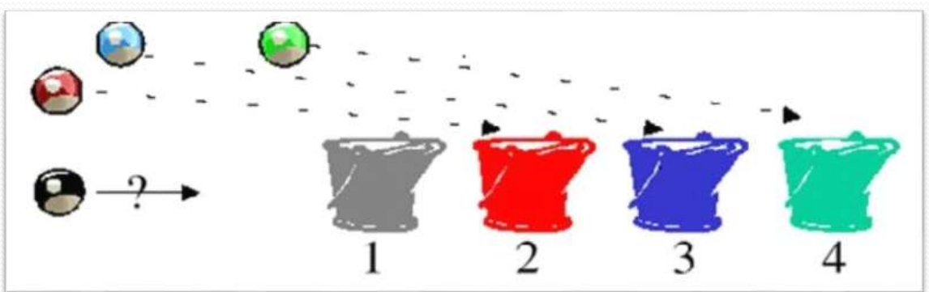
Classification
Classification is the process of predicting the class of a new item.
Therefore to classify the new item and identify to which class it belongs.

Slide 13
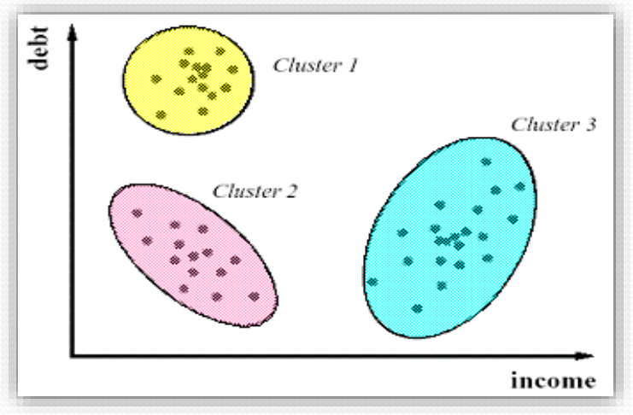
Clustering
Group Data into Clusters
Similar data is grouped in the same cluster
Dissimilar data is grouped in the same cluster

Slide 14
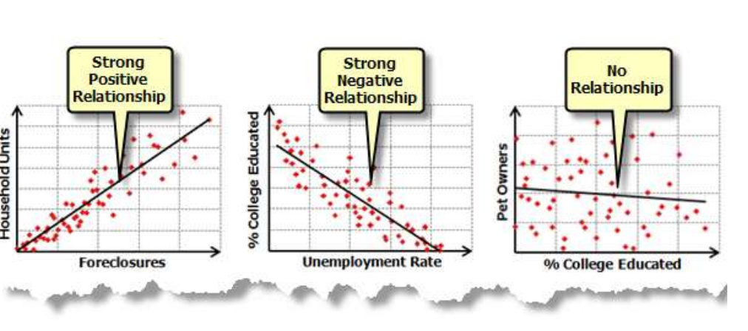
Regression Analysis
“Regression deals with the prediction of a value, rather than a class.”
Regression is a data mining function that predicts a number
For example, a regression model could be used to predict children's height, given their age, weight, and other factors.

Slide 15
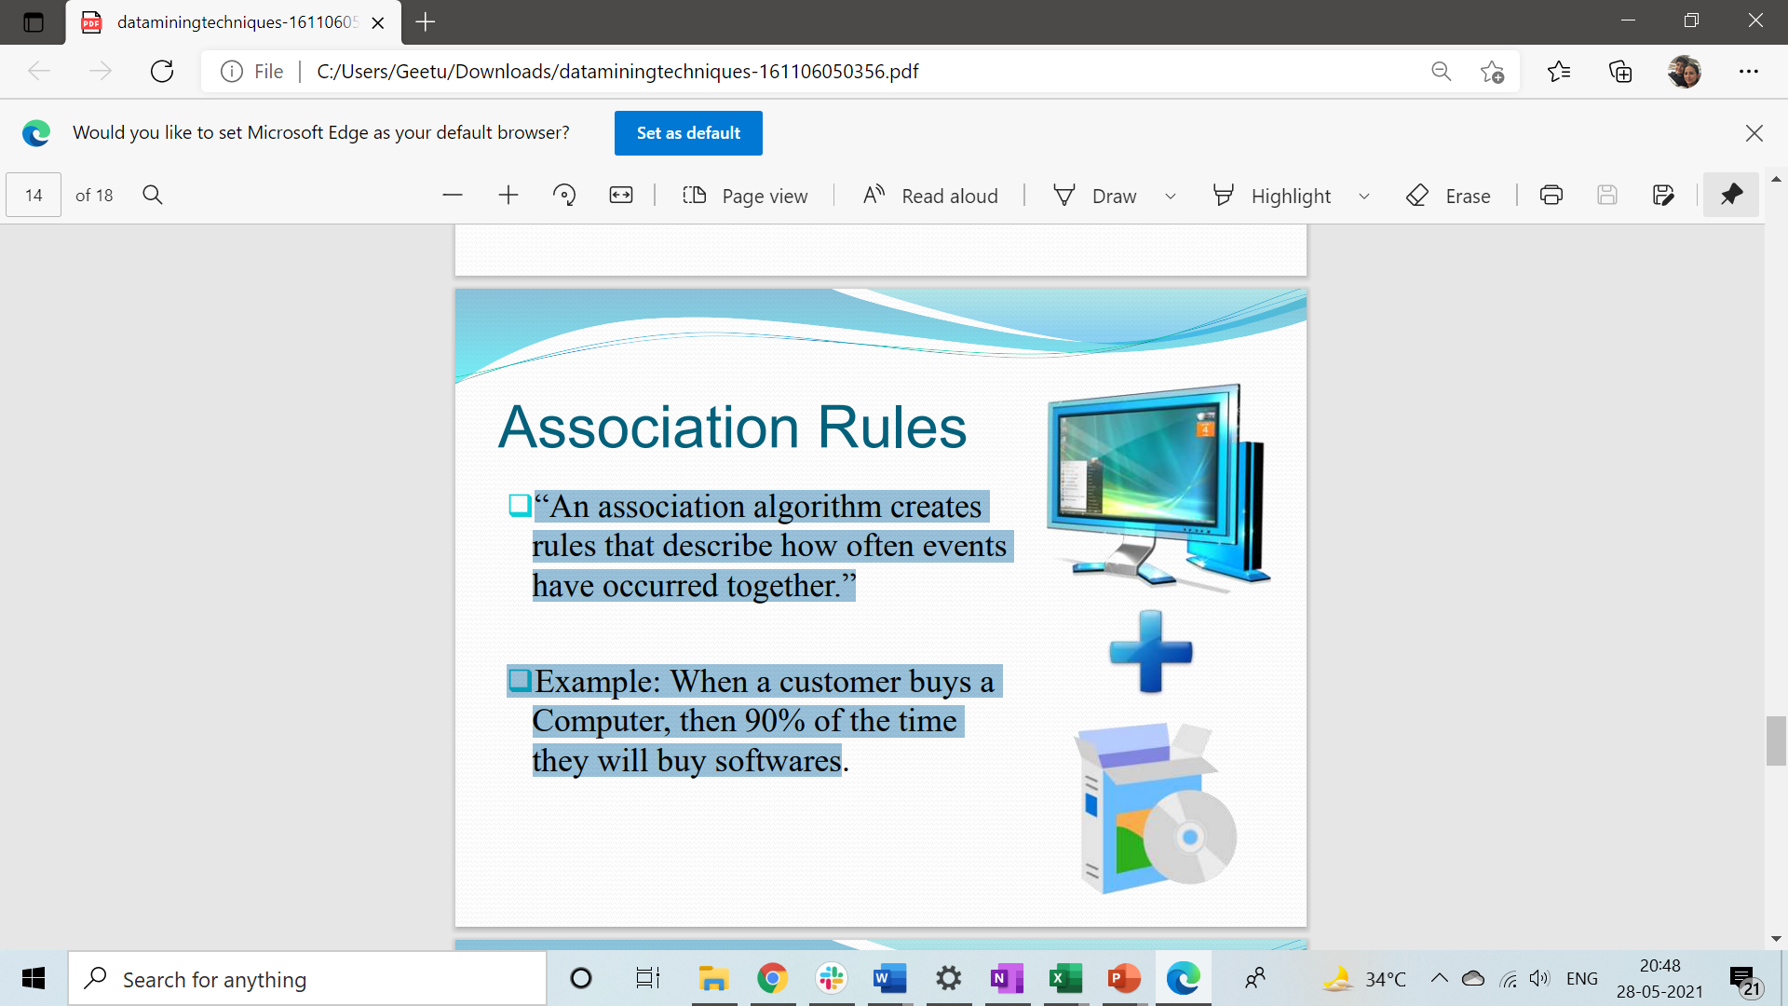
Association Rules / Affinity grouping
“An association algorithm creates rules that describe how often events have occurred together.”
Example: When a customer buys a Computer, then 90% of the time they will buy softwares

Slide 16
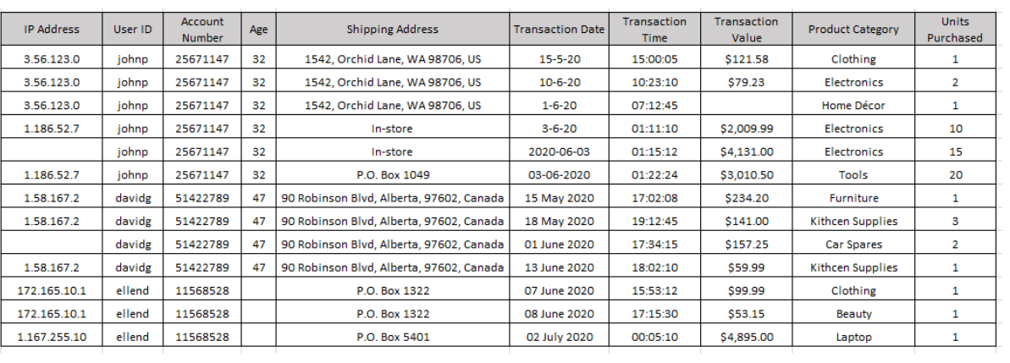
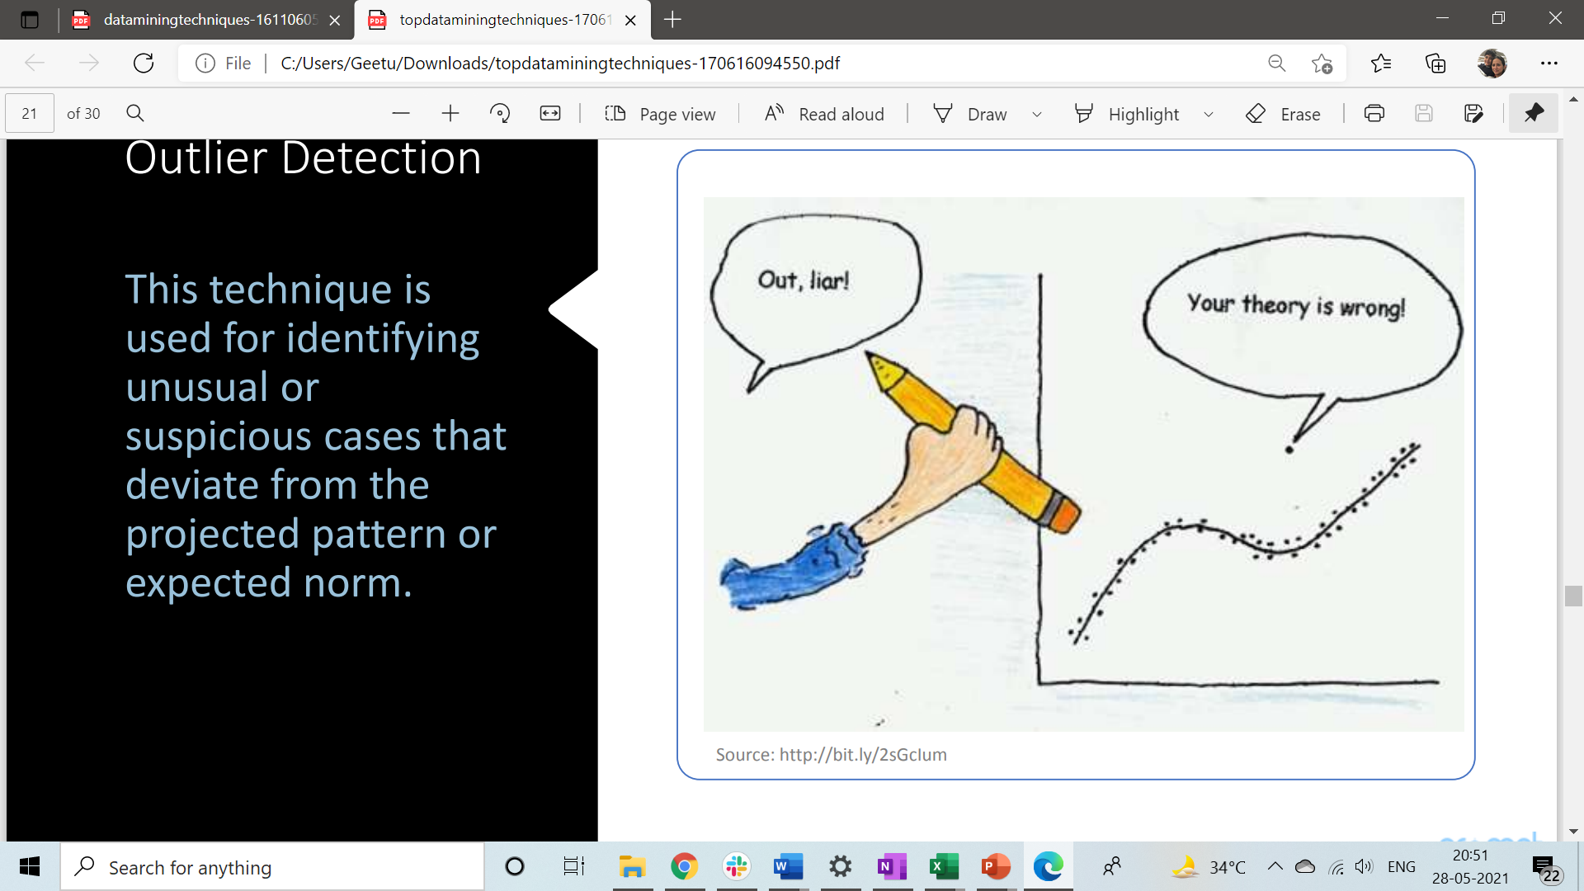
Outlier Detection
This technique is used for identifying unusual or suspicious cases that deviate from the projected pattern or expected norm. The applications of outlier or anomaly detection lies in identification of credit fraud, taxation fraud etc

Slide 17
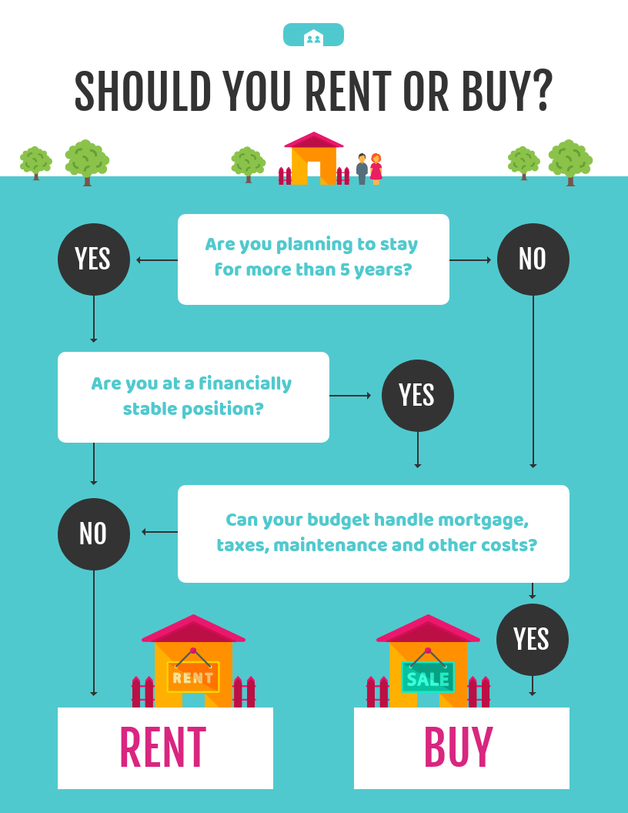
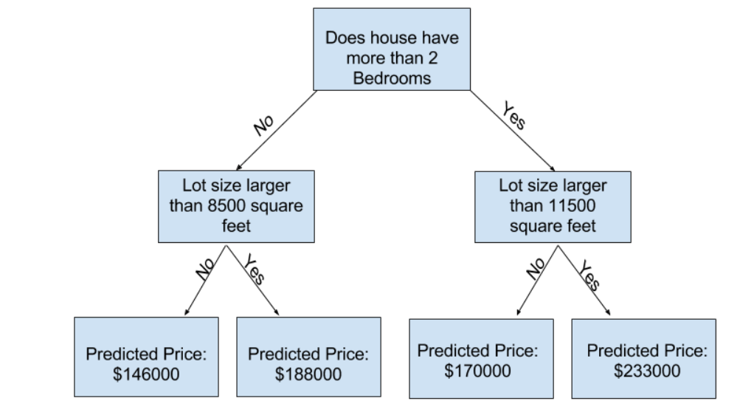
Decision Trees
Decision tree learning or induction of decision trees is one of the predictive modelling approaches used in statistics, data mining and machine learning. It uses a decision tree (as a predictive model) to go from observations about an item (represented in the branches) to conclusions about the item's target value (represented in the leaves).

Slide 18
Sequential pattern
Sequential pattern mining is a topic of data miningconcerned with finding statistically relevant patterns between data examples where the values are delivered in a sequence.It is usually presumed that the values are discrete, and thus time series mining is closely related, but usually considered a different activity.
Example, "if a {customer buys a car}, he or she is likely to {buy insurance} within 1 week",
Notes:
Another example:
With a great variation of products and user buying behaviors, shelf on which products are being displayed is one of the most important resources in retail environment. Retailers can not only increase their profit but, also decrease cost by proper management of shelf space allocation and products display. To solve this problem, George and Binu (2013) have proposed an approach to mine user buying patterns using PrefixSpan algorithm and place the products on shelves based on the order of mined purchasing patterns

Slide 19
Tools for Data Mining
Spreadsheets
Python
IBM SPSS
R- Language
IBM Watson Studio
SAS

Slide 20
Communicating Data Analysis Findings

Slide 21




Data Analysis Process
Starts with Understanding the problem and ends with communicating the findings in a way that impact decision making
To reconnect with your audience. Begin by asking yourself these questions:
Who is my audience?
What is important to them?
What will help them trust me?
Notes:
The success of your communication depends on how well others can understand and trust your insights to take further action.
As data analysts, you need to tell the story with your data by visualizing the insights clearly and creating a structured narrative explicitly targeted at your audience.
Your audience is mostly going to be a diverse group—in terms of the business functions they represent
Your presentation needs to be framed around the level of information your audience already
Has you will decide what, and how much, information is essential to enable a better understanding of your findings. You have to tell a compelling story.
Include only that information as is needed to address the business problem.
Begin your presentation by demonstrating your understanding of the business problem to your
audience.

Slide 22
Structure Your presentation
Reference your data
State your assumption
Organize your presentation
Identify the best formats for presenting your data
Notes:
Reference the data you have collected and share your data sources so people can trust your findings
establish the credibility don’t gloss over any key assumptions made during the analysis.
Organize information into logical categories based on the information you have
take a top-down or bottom-up approach in your narrative. Both can be effective—depends on your audience and use case.
If your audience doesn’t grasp the significance of your insight or are unconvinced of its utility, the insight will not drive any value.

Slide 23
Viewpoints: Storytelling in Data Analysis
Storytelling in Data Analysis
Notes:
A powerful visualization tells a story through the graphical depiction of facts and figures.
Data visualizations—graphs, charts, diagrams—are a great way to bring data to life.

Slide 24
Introduction to Visualization and Dashboarding Software
List some of the most commonly used data visualization software?

Slide 25
Introduction to Visualization and Dashboarding Software
List some of the most commonly used data visualization software?
Spreadsheets
Jupyter Notebook
Python libraries, like what?!
R-Studio and R-Shiny,
IBM Cognos Analytics
Tableau and Microsoft Power BI.

Slide 26
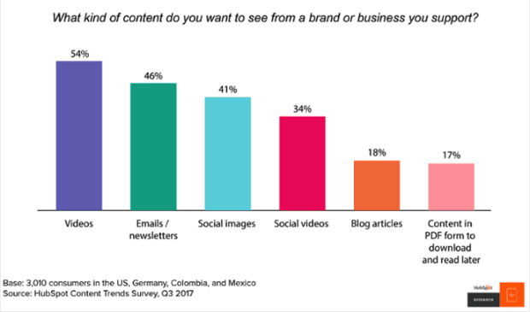
Activity
What is the story?

Slide 27
Activity
What is the story?

Slide 28
Activity
What is the story?

Slide 29
Activity
What is the story?

Slide 30
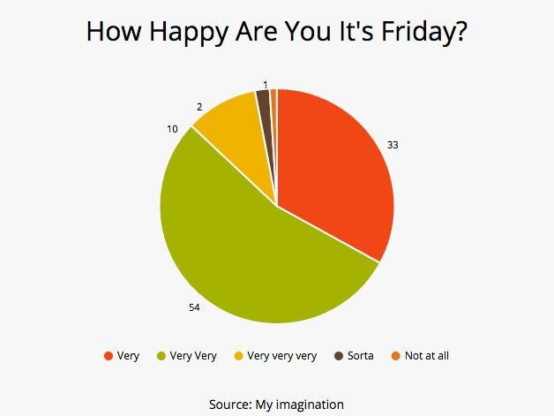
Activity
What is the story?

Slide 31
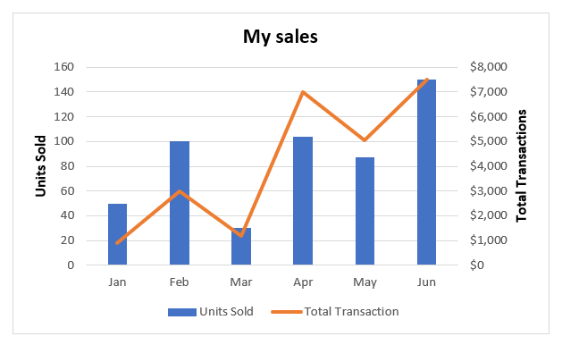
Activity
What is the story?

